Slide 1
Power BI Embedded
FSI CSU SWARM

Slide 2
Introduction

Slide 3
Abstract and learning objectives
Abstract and learning objectives
Embed Power BI objects within applications

Slide 4
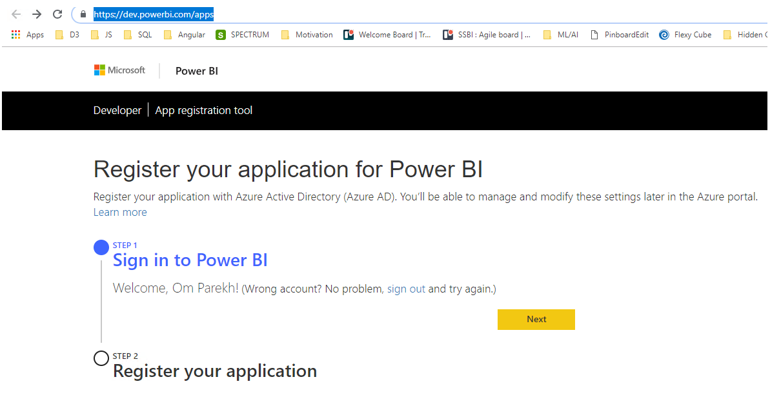
App Registration Tool
Step 1: Sign in to Power BI’s developer portal to register your application
https://dev.powerbi.com/apps

Slide 5
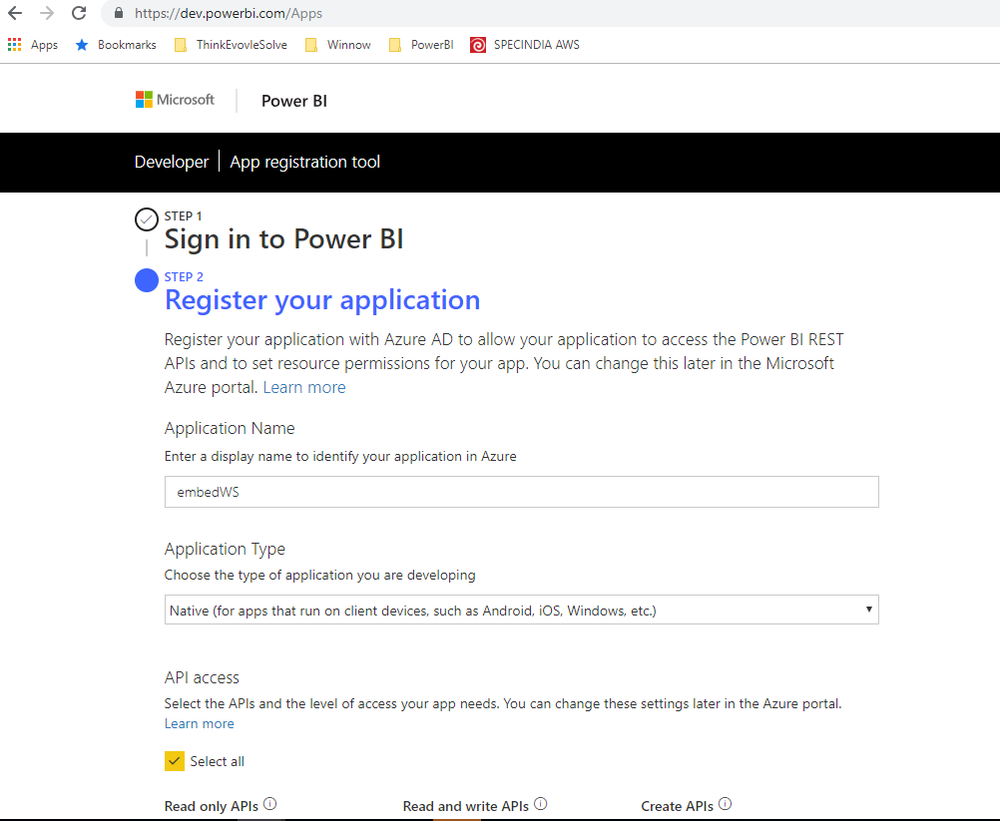
App Registration Tool
Step 2: Register your app by filling in the required fields
Remember the values for Application Name and Client ID
Example Client ID : 7114bf2f-8aad-49ad-8a7c-2e80e9b6fbba

Slide 6
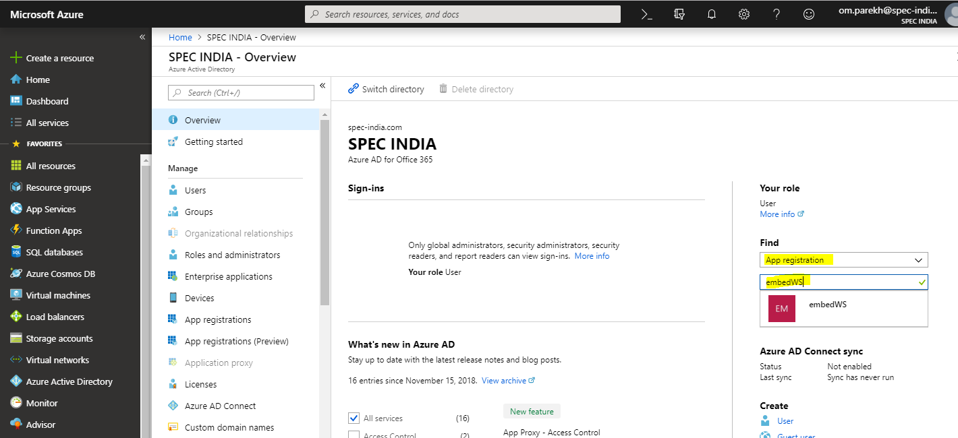
Grant Permission
Open the Azure Portal using the same Power BI Pro account used to register the application
Navigate to: Azure Active Directory
Setting ->
Required Permission ->
Grant Permission (select All)

Slide 7
Register an application in Azure Active Directory (Azure AD)
https://docs.microsoft.com/en-us/power-bi/developer/register-app

Slide 8
Wrap Up

Slide 9
Wrap-up
Outcome
Identify the preferred solution for the case study
Identify solutions designed by other teams
Timeframe
15 minutes

